Slide 1
Counterfactual Explanations

Slide 2
Explainability in ML
Critical decision-making situations in which the predictions of a black box ML model would not be sufficient
Healthcare: You have a 90% risk of heart disease in the next 2 years
Finance: You have been denied a loan due to a high risk prediction
Explanations should be interpretable and can serve a dual purpose:
Shed more light on the bias of the model
Should have some meaningful value for the user

Slide 3
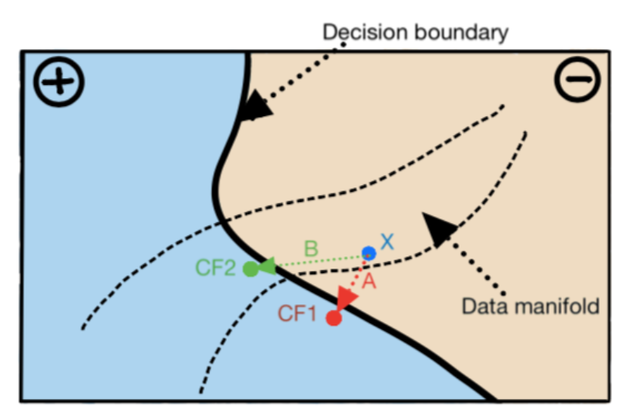
What are Counterfactual Explanations?
Emerging explainability technique in Machine Learning.
For a given datapoint and model, a counterfactual explanation is a datapoint in the vicinity but with a different prediction.
Helpful in answering questions about the changes required to be brought for getting to other side of decision boundary.

Slide 4
Loan Application Scenario
We cannot offer you loan currently. Contact us in few weeks.
Why: Most common reasons for the rejection
Credit Score
Educational Qualification
How: Counterfactual Explanation
You would have received the loan if your Education was PhD

Slide 5
Counterfactual Explanations for Machine Learning: A Review

Slide 6
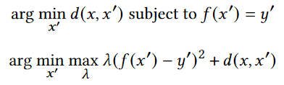

Major Themes of Research
Validity
minimize the distance between the coun- terfactual $x′$ and the original datapoint $x$
subject to the contraint that the output of the classifier is $y′ε𝒴$
differentiable, unconstrained form

Slide 7


Major Themes of Research
Actionability
which features are mutable (e.g.income, age…)
call the set of actionable features: $𝒜$

Slide 8

Major Themes of Research
Sparsity
people find it easier to understand shorter explanations
change smaller number of features in order to be most effective.
include a penalty function which encourages sparsity in the difference between the modified and the original datapoint， e.g. L0/L1 norm

Slide 9

Major Themes of Research
Data Manifold
The counterfactual should be close to the observed data (training data)
data manifold closeness

Slide 10
Desiderata of Counterfactual Explanations
Model access
Optimization amortization
Sparsity, Data manifold, Causal relation
Feature preference, Categorical distance function

Slide 11
Properties of counterfactual algorithms
Model access
access to complete model internals
Uses a solver based method like, mixed integer programming or operate on decision trees
access to gradients
restricted to differentiable models only
access to only the prediction function (black-box)
Only 35% of the approaches are model-agnostic and work in black-box fashion.

Slide 12
Properties of counterfactual algorithms
Optimization amortization
mostly returned a single counterfactual for a given input datapoint
A smaller number of the methods are able to generate multiple counterfactuals
Only [1] learns a strategy to generate counterfactuals which can be later used for any datapoint from the data distribution
[1]Divyat Mahajan, Chenhao Tan, and Amit Sharma. 2020. Preserving Causal Constraints in Counterfactual Explanations for Machine Learning Classifiers

Slide 13
Properties of counterfactual algorithms
Sparsity
Shorter explanations are more comprehensible
Preferable to alter a few features, rather than small changes in all features.
Using L0/L1 norm, changing features iteratively, or post-hoc sparsity are a few methods for inducing sparsity.

Slide 14
Properties of counterfactual algorithms
Data manifold
An attainable counterfactual should be close to training data .
Adding a VAE loss term, constraining distance from k-nearest datapoints, and sampling from latent space are some ways of attaining it.
Only 35% of the papers consider closeness to data manifold
Causal relation
An effective counterfactual must respect the causal relations among features
Only 3 of previous papers consider causal relations among features, out of which only one can work with partially specified causal graphs.

Slide 15
Properties of counterfactual algorithms
Feature preference
An effective counterfactual must not change immutable and unactionable features, e.g., citizenship, marital status.
Actionable features are a subset of mutable features.
Only 35% of previous papers consider actionability among features
Categorical distance function
convert categorical features to one-hot encoding and then treat them as numerical features.

Slide 16
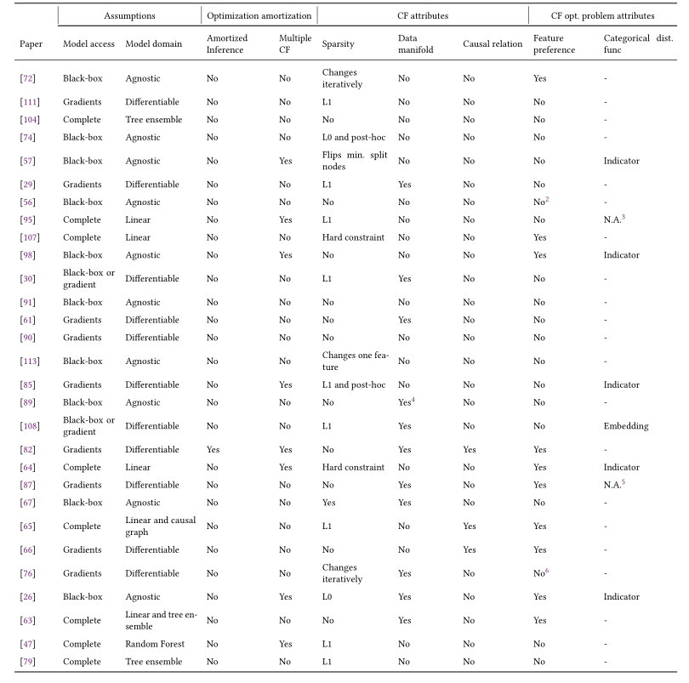

Slide 17
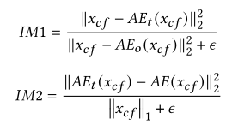
Evaluation Metrics
Validity
Proximity
Sparsity
Diversity (if applicable)
Causal relation satisfaction
Closeness to data manifold
Time taken

Slide 18
Open Questions
Considering bias while generating counterfactuals
Generating robust counterfactuals
Counterfactuals as an interactive service
Counterfactuals as discrete and sequential steps of actions

Slide 19
Conclusions
We collected papers in counterfactual explanations and tied them in a lucid manner to serve as an introduction as well as platform for reckoning current research.
We developed a rubric to evaluate past and future research on counterfactual explanations.

Slide 20
Preserving Causal Constraints in Counterfactual Explanations for Machine Learning Classifiers
Divyat Mahajan (Microsoft Research India)
Chenhao Tan (University of Colorado Boulder)
Amit Sharma (Microsoft Research India)

Slide 21
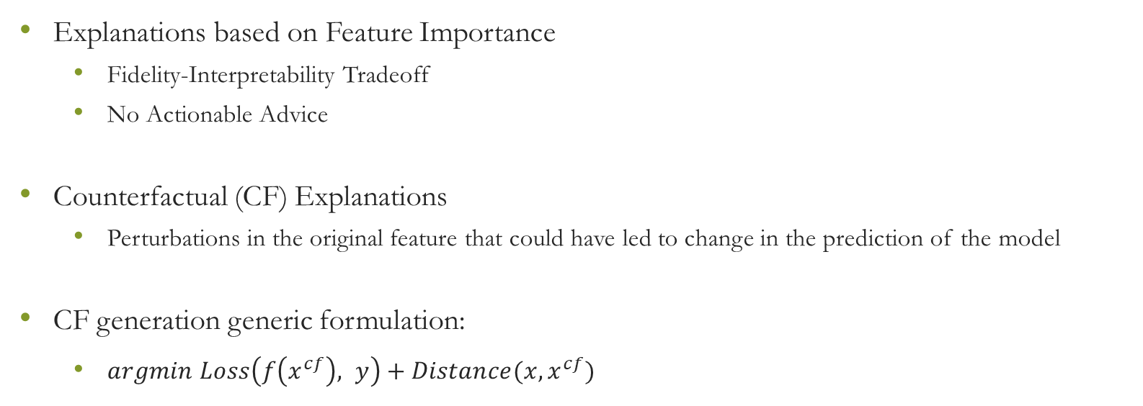
Counterfactual Explanations
Explanations based on Feature Importance
Fidelity-Interpretability Tradeoff
No Actionable Advice
Counterfactual (CF) Explanations
Perturbations in the original feature that could have led to change in the prediction of the model
CF generation generic formulation:
$argmin Loss\left(f\left(x^{cf}\right), y\right)+Distance(x, x^{cf})$

Slide 22
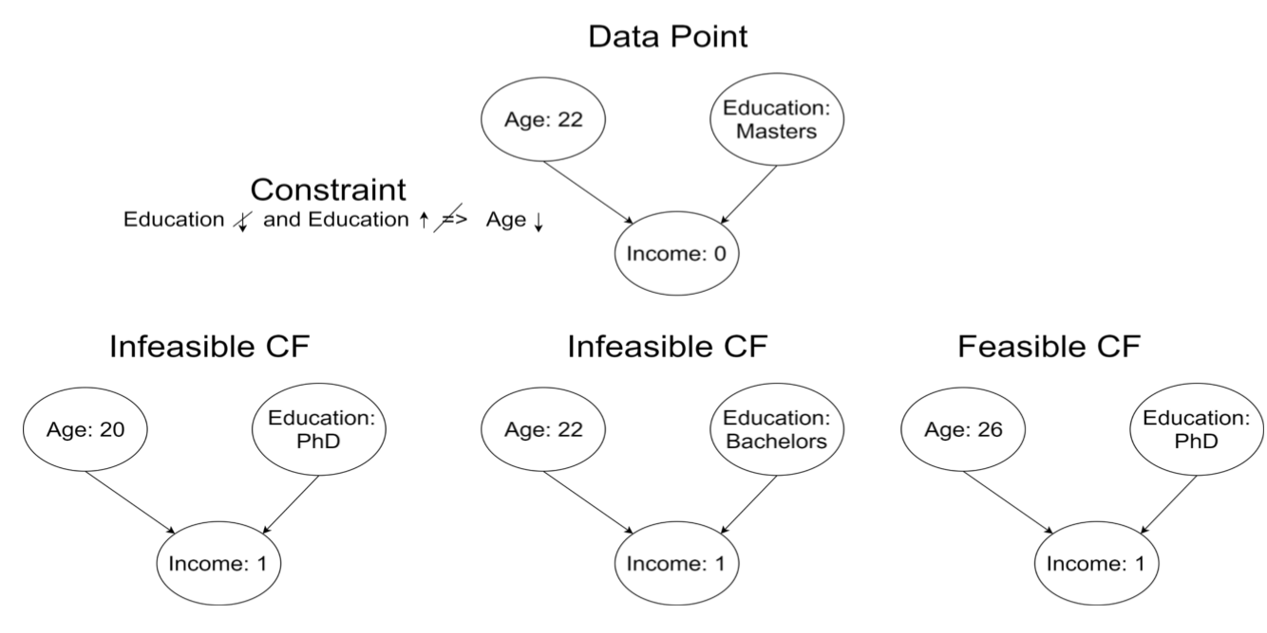
Issues with Counterfactual Explanations
Independent feature perturbation lead to infeasible CF explanations

Slide 23
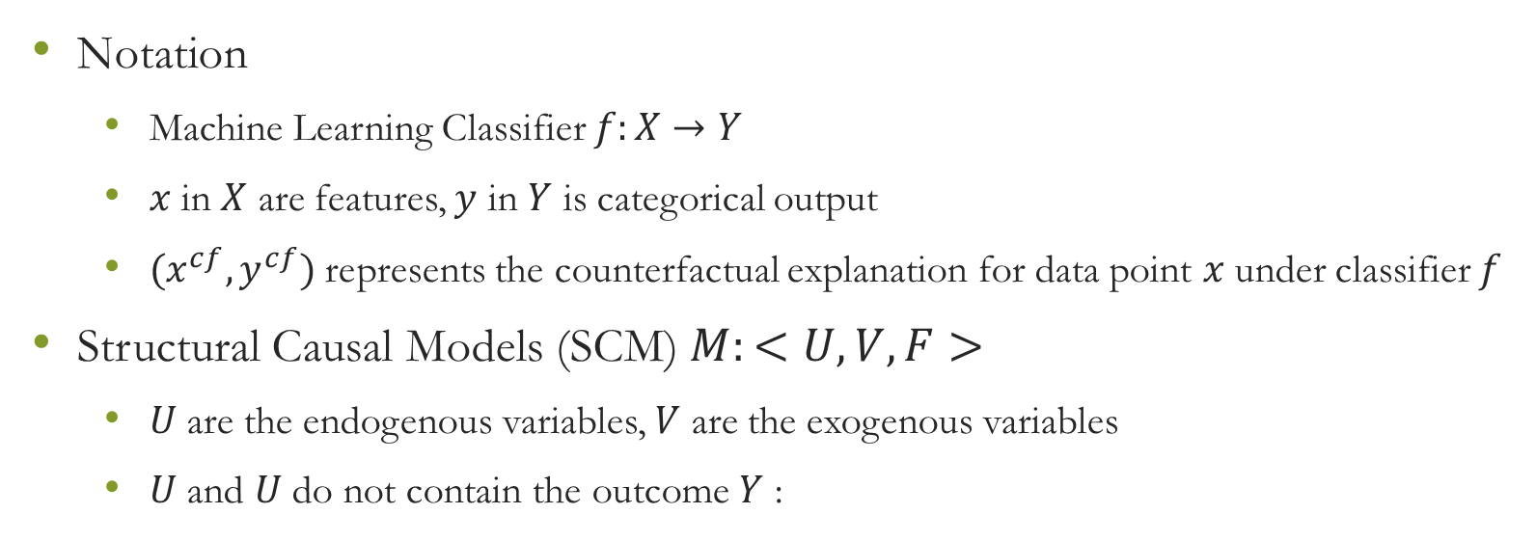
Feasibility of Counterfactual Explanations
Notation
Machine Learning Classifier $f:X→Y$
$x$in $X$ are features, $y$ in $Y$ is categorical output
$(x^{cf}, y^{cf})$ represents the counterfactual explanation for data point $x$ under classifier $f$
Structural Causal Models (SCM) $M:<U,V,F>$
$U$ are the endogenous variables, $V$ are the exogenous variables
$U$ and $U$ do not contain the outcome $Y$ :

Slide 24
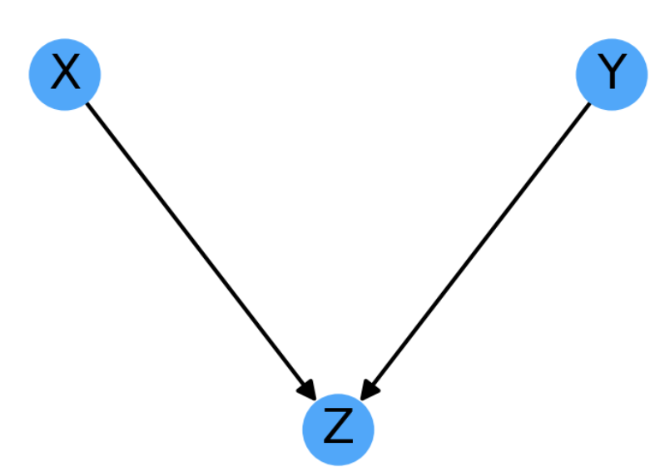

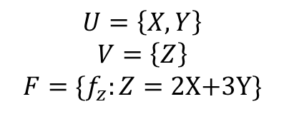
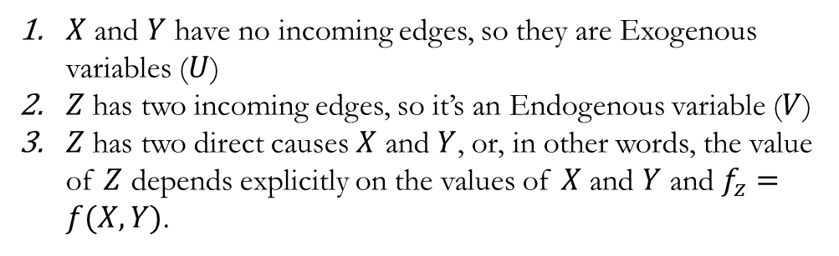
Structural Causal Models
Structural Causal Model
$V$: Endogenous
$U:\text{Exogenous}$
$F$: determine the value in $V$ based on values of $U∪V$
$X$ and $Y$ have no incoming edges, so they are Exogenous variables ($U$)
$Z$ has two incoming edges, so it’s an Endogenous variable ($V$)
$Z$ has two direct causes $X$ and $Y$, or, in other words, the value of $Z$ depends explicitly on the values of $X$ and $Y$ and $f_{z}=f(X, Y)$.
$$U=\left\{X,Y\right\}$$
$$V=\left\{Z\right\}$$
$$F=\{f_{z}:Z=\text{2}\text{X}\text{+3}\text{Y}\}$$

Slide 25
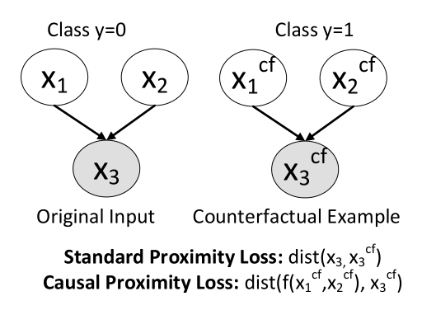


Causal Proximity Regulariser
Perturbation in feature $v$ should be causally related to perturbations in other features instead of just being proximal
Given the knowledge of SCM, we can preserve global feasibility with a better notion of Distance for endogenous nodes
Combined with any prior CF generation method
$$argmin Loss\left(f\left(x^{cf}\right), y\right)+Distance\left(x, x^{cf}\right)⇒argmin Loss\left(f\left(x^{cf}\right), y\right)+DistCausal\left(x, x^{cf}\right)$$

Slide 26
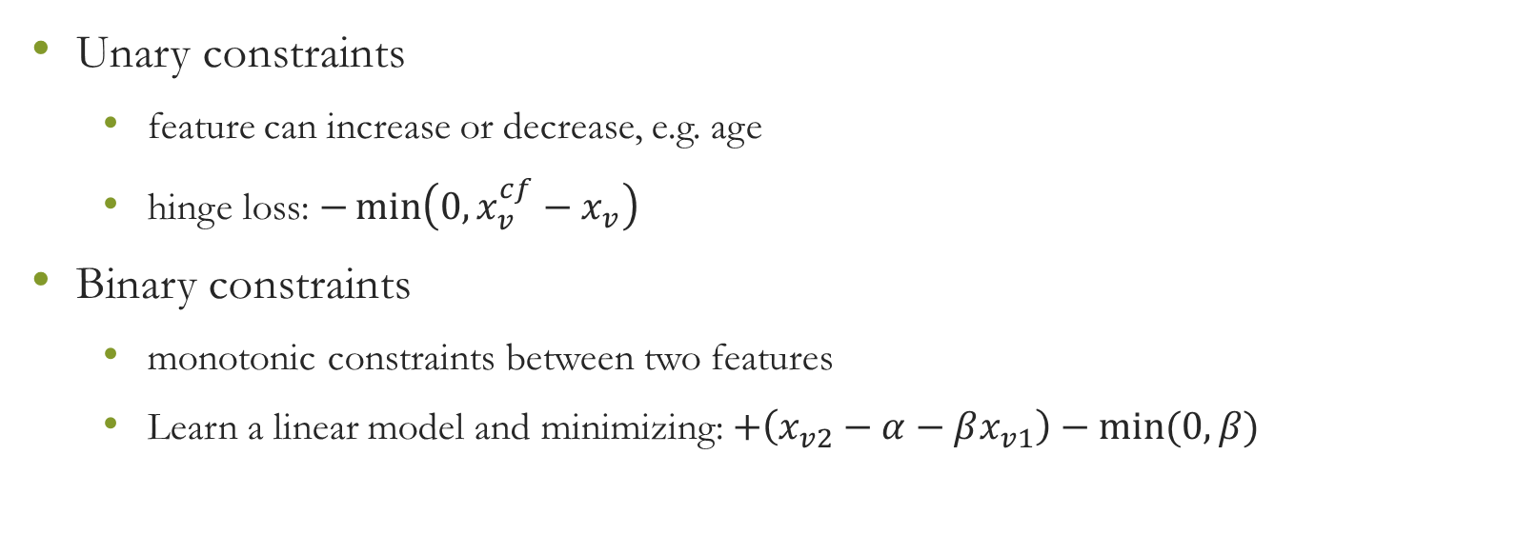
Approximation Loss
Unary constraints
feature can increase or decrease, e.g. age
hinge loss: $−\min\left(0, x_{v}^{cf}−x_{v}\right)$
Binary constraints
monotonic constraints between two features
Learn a linear model and minimizing: $+\left(x_{v2}−α−βx_{v1}\right)−min⁡(0, β)$

Slide 27
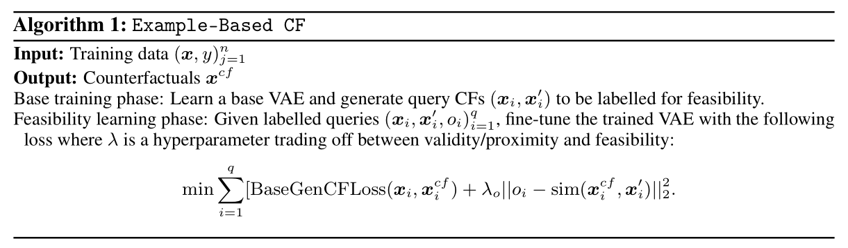
Example-Based Generation
Learning from Oracle/Expert
Modelling the constraint implicitly via Oracle which provides access to feasibility score
Oracle may represent user/human feedback
Learn feasibility constraints through this feedback

Slide 28

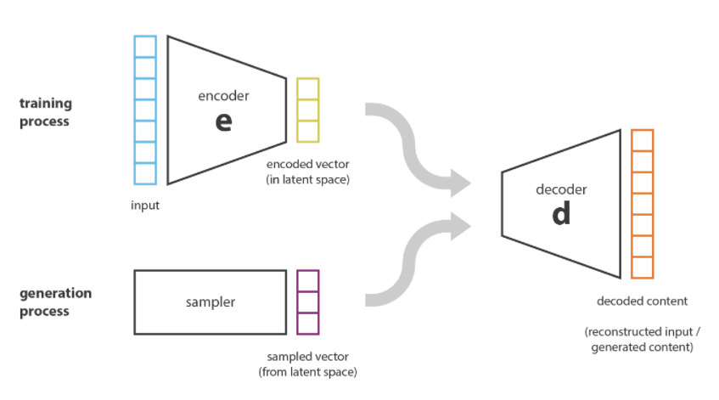


Base VAE generator for CF explanations
Maximizes $\operatorname{Pr}\left(x^{cf} | y^{′},x\right)$ where $x^{cf}$ belong to class $y′$
First arrive at a latent representation $z$ for the input instance $x$ via the encoder $q(z|x,y′)$
Then generate the corresponding counterfactual $x^{cf}$ via the decoder $q(x^cf|z,y′)$
reconstruction term
regularisation term

Slide 29
Empirical Evaluation
Datasets
Methods
Model-based CF
Model-approx CF
Example-Based CF
CEM
 | # of samples | Causal model | Constraint
Simple-BN | 10,000 | Known | Two monotonicity constraint
Sangiovese | 10,000 | Known | Two monotonicity constraint
Adult | 15691 | Not known | a unary constraint, a monotonic constraint

Slide 30
Evaluation Metrics
Target-Class Validity
Cont-Proximity: Proximity for continuous features
Cat-Proximity: Proximity for categorical features
Constraint Feasibility Score
Causal-Edge Score

Slide 31
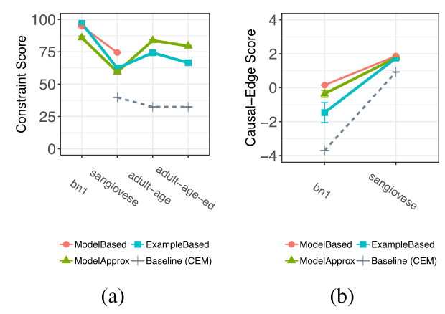
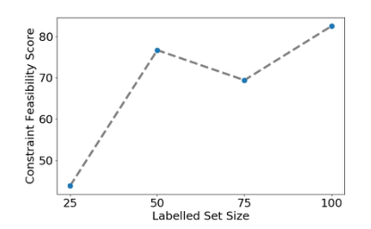
Result
Constraint-Feasibility score as the no.of labelled examples is increased for global constraints in Adult
Constraint-Feasibility for three datasets,
Causal-Edge score for BN1 and Sangiovese.

Slide 32
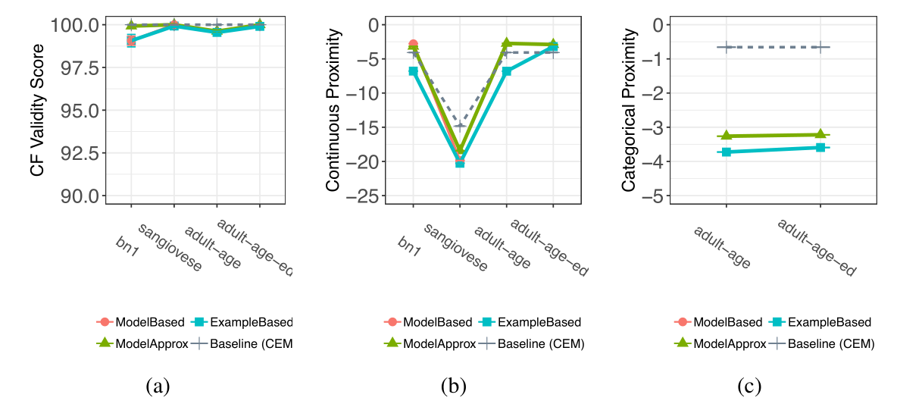
Result
Validity, Continuous Proximity and Categorical Proximity metrics for different CF explanation methods.

Slide 33
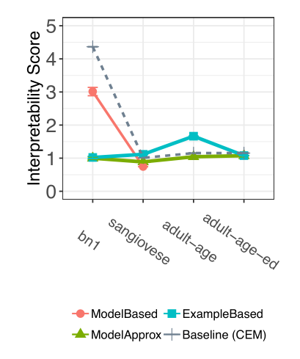
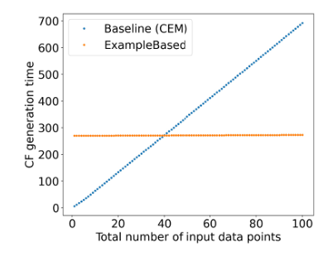
Result
Comparison of the time taken to generate CF examples for the proposed Example-Based CF method and the baseline CEM method. After about 40 inputs, Example-Based CF is faster than CEM for generating CF examples.
Interpretability score (IM1) for different CF generation methods. Lower IM1 score is better

Slide 34
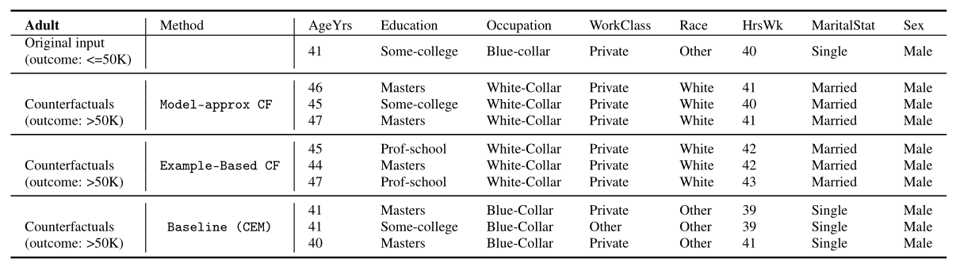
Case Study

Slide 35
Conclusion
Poor performance of state of the art method on feasibility of CF Explanations
Generative framework for CF Explanations
Computational advantage
Easy extensions to preserve constraints

